Slide 1











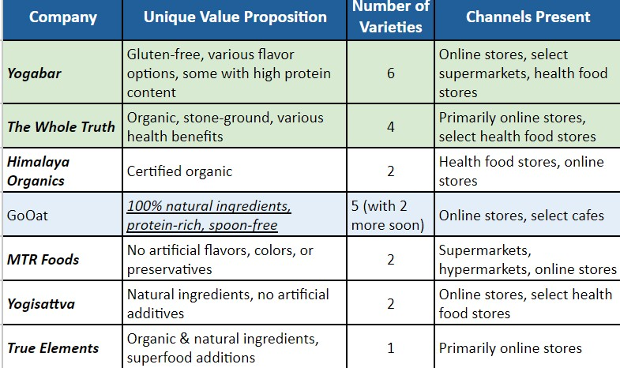





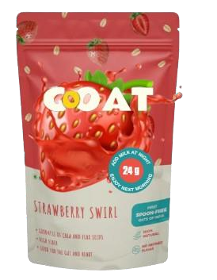

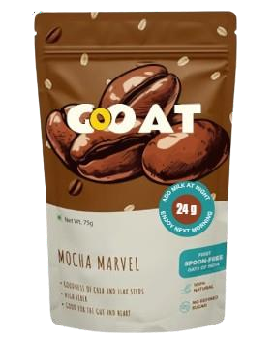
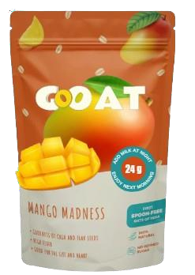














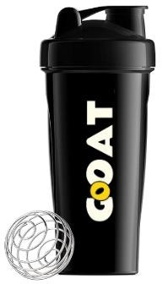














Product & Branding
Developing Engaging Product Journey
Marketing & Community Building
BRAND TAGLINE & VALUE PROPOSITION
Oatventure Awaits!!!
Problem Statement
Competitor Analysis
Design a product journey align with the Indian ecosystem while clearly positioning GoOat's as the brand for health, taste, and convenience.
We see that while bigger players are organic and have a wide variety of flavors, the protein content and the convenience that comes with GoOat would be the key differentiator in the category.
We believe mornings shouldn't be a blur of routine. They should be an explosion of flavor, a chance to fuel your body and ignite your spirit. That's why GoOat exists, not just as another breakfast option, but as a portal to an Oatventure.
Current Unique Value Propositions
Protein power: Packed with 17g-24g protein per
serving, perfect for muscle health and satiety.
Grab-and-go convenience: Ready-to-eat, spoon-free, and portable, ideal for busy lifestyles.
All-natural: Made with 100% natural
ingredients, free of artificial nasties.
Flavor fiesta: 5 delicious flavors + 2 coming soon, catering to diverse preferences.
UPDATED PACKAGING
USP (Whey protein
WHEY PROTEINWHEY PROTEIN POWEWHEY PROTEIN POWERED OATVENTURE
contents) highlighted
on the seal
OATVENT
POWERED URE
RED OATVENTURE
Kept the logo intact for brand recall and familiarity
Busy Bani(28, Consultant)
Fit Farhad(27, IT Employee) “I need something protein heavy that can compliment my whey protein intake but I don’t know how to cook!! ” Demographics & Psychographics Gym enthusiast. Consumes whey protein as a part of daily diet. Meal prep is beyond his capability and anything ready made is unhealthy to his lifestyle choices. Wants easy + flavour + health in his breakfast | Lazy Lalit (22, Student) “I need something filling and quick for my breakfast but due to tight schedule, I barely get any time.”
 | Demographics & Psychographics
 | Student from Bhubaneswar. Often skips meals due to busy schedule. Needs something healthy, lean, yet filling. Very picky about taste and often ends up binging on sugary breakfasts.
 | NEED GAP: Versatile, healthy and budget-friendly option & keep fuller for longer with their flavorful goodness.
NEED GAP: A healthy, tasty, and balanced breakfast with protein & fiber to compliment active lifestyle
Revamped look with bigger, more prominent image of the flavor
“I need to get ready within 20mins. An easy & nutritious breakfast option which I can carry. ”
Target User Personas
Pain-Points
The GoOat Magic
Soak overnight to consume
17gms & 24gms protein rich food
Demographics & Psychographics
Protein Rich &
Healthy
Lives alone in Bangalore
Very busy schedule with little time to cook healthy meals
Often ends up consuming cakes/other
unhealthy packed items for breakfast.
Minimal meal prep
The NEW PACK
comes with
a shaker
On-the-go
Consumption
NEED GAP: Minimal prep and portability - the perfect grab-and- go breakfast for busy mornings and active lifestyles
Taste + Health + No-Cook
1 Shaker Meal
Filling Breakfast
Exciting favours

Slide 2







Product & Branding
Developing Engaging Product Journey
Analysing the Product Journey of GoOAT
Marketing & Community Building
JOURNEY
PHASES
TRIGGER & AWARENESS
DISCOVERY
CONSIDERATION TRIAL & CONVERSION
LOYALTY
Social media ads, influencer partnerships Online articles about healthy breakfast trends Placement in health stores | Checks availability on e-comm & quick comm platforms Compares offers with other brands | Engaging website with clear information & product details Social Proof with testimonials & reviews | Tries the product Compares with previous purchases in terms of taste + convenience | - Fixates with a re-purchase plan Touchpoint already exists Lacks and needs to improve
KEY
FUNCTIONS
ADDRESSING THE GAP BETWEEN OUR VIABLE CONSUMER & GoOAT
L o w A w a r e n e s s
L i m i t e d O f f l i n e p r e s e n c e r e s t r i c t s t r i a l
N o t e n o u g h t r u s t a s s o c i a t e d w i t h a n e w b r a n d
S t r o n g W o r d - Of - M o u t h n e e d e d
D E V E L O P I N G I N V E N T I V E T O U C H P O I N T S T O I M P R O V E T H E C U R R E N T P R O D U C T J O U R N E Y
Organizing contests: Flavour Innovation
Exclusive Offers & Rewards: Loyalty programs, birthday discounts, early access to new flavor
GoMorning Challenge: Partnering with fitness influencers or local gyms for a week where
participants share their GoMorning
breakfast routines and track their energy levels.
Offering discounts or exclusive merchandise to winners.
Website & Content: Adding the FAǪ section and recipe ideas.
Increasing product placement on
Ǫuick Commerce
Trial Kits: Affordable starter packs with multiple flavor options to encourage testing different varieties
Flexible Subscription Options with personalized preferences and discounts for regular customers
Social Proof: Vibrant social media presence with real people enjoying GoOAT and a flavor showdown
Single-serve packets or on-the-go options: Limited edition pouches with easy-grip features and leak-proof closures

Slide 3


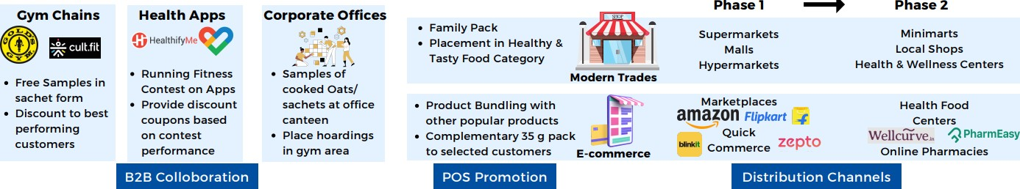



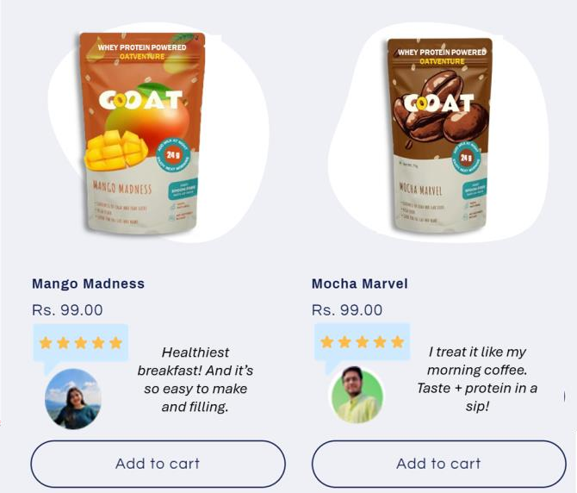





Product & Branding Developing Engaging Product Journey Marketing & Community Building
Here’s a revamped retail promotional strategy to improve discoverability of the product through an omnichannel approach to
get the right quantity of product at the right time to the user.
Most Viable Customer Segment
Age 18-45
Indian Metros,
Tier I, II++
Medium - High
Discoverability
disposable
income
Behavioral
Busy individuals. Often living alone.
Health-conscious individuals trying to maintain an active & healthy lifestyle
Parents & employees seeking convenient,
healthy breakfasts
Purchase behavior: Influenced by online & digital campaigns.
Multichannel presence along with organic promotions is important to build trust
Online Campaign Ideas based on pain points of the TG:
So good, they're practically swole-food:
Highlighting how the food is high protein
Breakfast of dreams - ready while you dream : Highlighting the low effort nature of cooking and how it’s ready overnight.
Grab, go, and conquer your day: Highlighting
convenience and strength of oats.
PHASE 1
PHASE 2
PHASE 3
Engage with youtubers like Beer Bisceps, Mumbiker Nikkhil, MostlySane, Cookingshooking for promoting GoOats through their channels
Targeted Digital Marketing with Digital campaigns on social media with hashtag #SuperHealthyWithS uperOats, Competitions on online platforms
Run re-targeting campaigns on website visitors and post interactions across platforms on Youtube and Instagram with the taglines,
Promotions
Customer Testimonials
Reviews to
build trust
Introducing an Application
The GoOAT Hub
A digital platform that serves as a hub for health and wellness information. This platform can include blog posts, recipe ideas, and live sessions with nutritionists, creating a comprehensive ecosystem around GoOAT.
Indian Ecosystem Compatibility
The oats being positioned as an “On The Go
Retention
breakfast”. As
world's largest tea-drinking
nation, Indians have an inclination for tea in
the morning. Hence, “Chai Shakti” can be a new flavour variant to attract more customers.

